Slide 1
SEMINAR
Name | Anand D R
Branch | Computing technologies and Virtualization.
Registration Number | 171041004
Topic | Dockers and Containers
Panel Members | Prof. Sathyanarayana Shenoy. Prof. Mohan Kumar J.

Slide 2
CONTENTS
Introduction
Key factors for Docker or container invention.
Docker in general(Basic architecture).
Benefits of Dockers and containers.
Docker Engine.
Docker architecture.
Docker objects
Underlying technologies.
Some examples..
Disadvantages of Dockers.
Conclusion
References

Slide 3
INTRODUCTION
Docker is a software whose first release was on 13th march 2013.It is developed in Go language.
It falls under computer virtualization technology, its also called light weight virtual machine.
Its an open source which is widely used for developing, shipping and running applications.
It is used to separate applications from infrastructure so that it can be delivered easily and quickly.
These dockers can also be loaded into virtual machines.
These are lightweight and does not require extra load of hypervisor as in virtual machines.
These Dockers fall under OS-level virtualization in which host operating system will be at the base and virtualization layers are on top of it and run as an application within the operating system.

Slide 4
Virtual Machines
VM1
Guest
VM2
Guest
VMn
Guest
Host Applications
Hypervisor
Host Operating System
Hardware (CPU,RAM,etc)

Slide 5
DISADVANTAGES OF VIRTUAL MACHINES
Management- Virtual environments needs to be instantiated, monitored, configured and saved.
Difficulty in direct access to hardware.
Performance- When multiple virtual machines are simultaneously running on a host computer, each virtual machine may introduce an unstable performance, which depends on the workload on the system by other running virtual machines.
High RAM consumption since each virtual machine will occupy a separate area for its execution.
High use of disk space, since it takes all the files for each operating system installed on each machine.

Slide 6
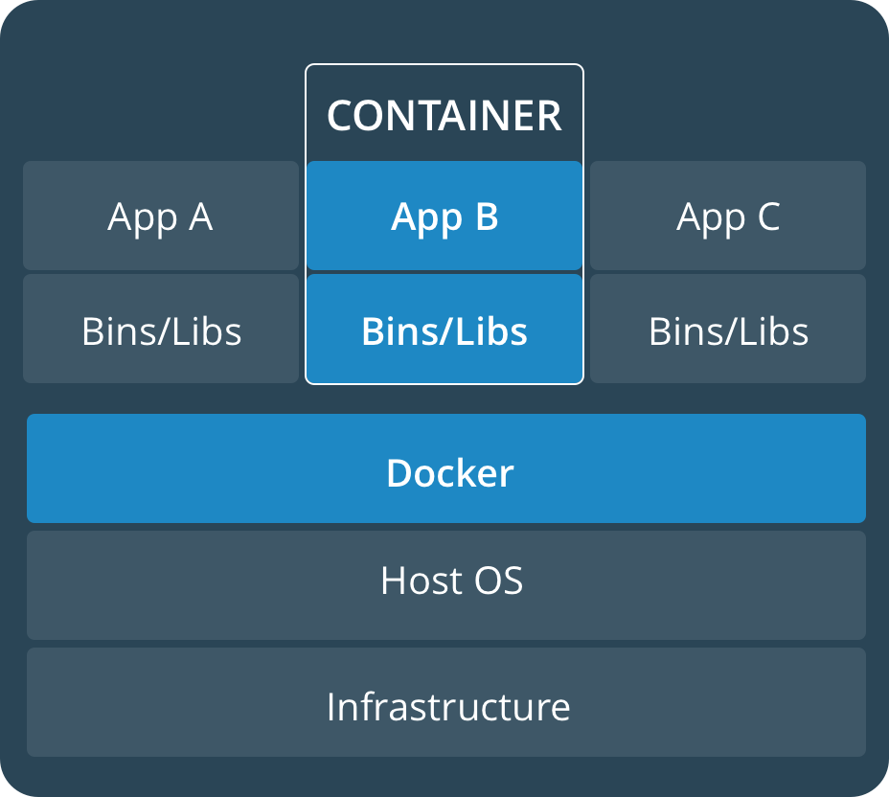
DOCKER IN GENERAL
Infrastructure: is the hardware upon which the Host OS runs.
Docker is a piece of software which host multiple containers.
.App A, App B and App C are applications that are hosted in different containers with required dependencies.

Slide 7
BENEFITS OF DOCKERS - CONTAINERS
Application Portability : Dockers add all dependencies that the application need along with it inside the containers so that it can be shipped to different platforms.
Lightweight and fast : Compared to VM’s these are lightweight and fast since there is no operating system.
Resource Utilization optimal : Dockers use Linux’s control group which allows allocating memory, CPU memory, network and disk resources.
Best fit for Micro services architecture : Each micro services can be deployed into containers without interfering other micro service container.
Responsive deployment and scaling: Dockers portability and lightweight nature makes it easy to manage workloads, scaling.

Slide 8
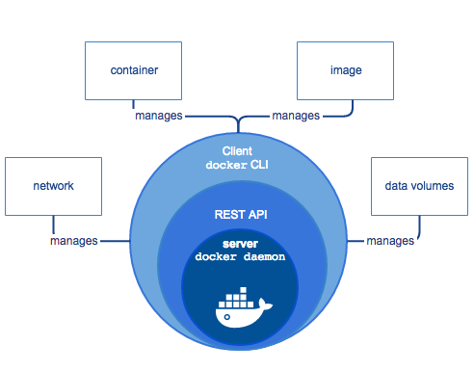
DOCKER ENGINE
A server which is a long-running program called as daemon program.
A REST API which specifies interfaces that program can use to talk to the daemon.
A command line interface client(CLI),which are used by other applications to communicate with daemon.
The CLI uses the Docker REST API to control or interact with the Docker daemon through scripting or direct CLI commands.

Slide 9
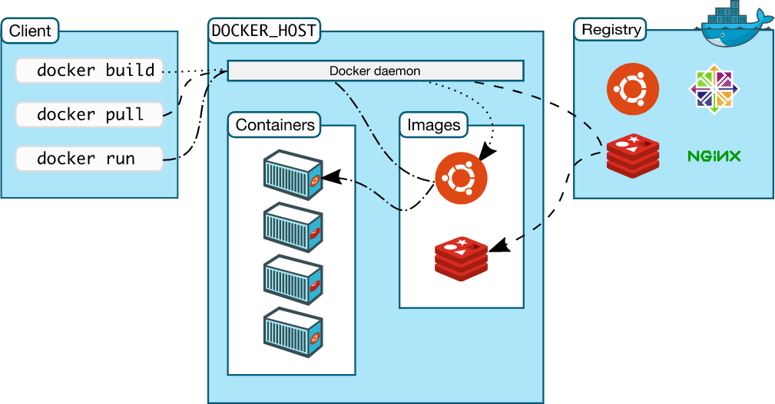
DOCKER ARCHITECTURE

Slide 10
Docker daemon : It listens to API request and manages Docker objects such as images, containers, networks and volumes. These daemons can communicate with other daemons to manage docker services.
Docker Client : Docker users uses these clients to interact with Docker.
Docker registers : These stores Docker images. Docker hub and Docker cloud are two public registers. Docker is configured to look into Docker hub for images by default. Docker pull and Docker run commands checks for images in the registries. When Docker push command is executed the image is pushed into your configured registry.

Slide 11
DOCKER OBJECTS
Images : These are read only contents for creating docker containers. We can build these images by using Dockerfiles. Each instruction in the Dockerfile creates a layer in the image.
Containers : This is a runnable instance of a image. We can run, stop, move and delete a container using Docker API or CLI.
Services : These allow you to scale containers across multiple daemons, which all work together as a swarm with multiple managers and workers. Each member is a docker daemon and all communicate with the help of docker API.

Slide 12
UNDERLYING TECHNOLOGY
Namespaces : Docker uses a technology called namespaces to provide isolated workspaces called the container. When a container is powered on, Docker creates a set of namespaces for that containers.
pid namespace : Process isolation.
net namespace : Managing network interfaces.
ipc namespace : Managing access to IPC resources.
Control groups : Docker engine also relies on another technology called control groups. This cgroup limits an application to a specific set of resources. These allow to share hardware resources as well as impose limits and constraints.
Union file system : These operate by creating layers, making them very lightweight and fast.
Container format: Docker engine combines namespaces, control groups and UnionFs into a wrapper called container format. Default format is libcontainer.

Slide 13
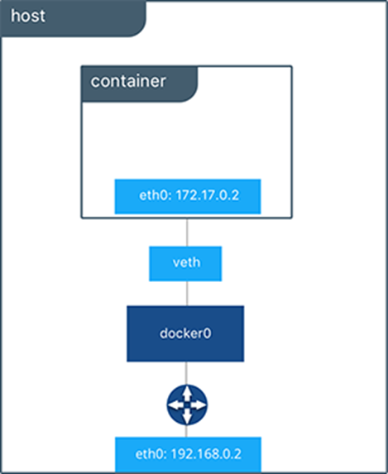
EXAMPLES
Creating a network container
Docker provides two networks drivers for hosting the containers or for connecting the containers to outside world.
1)Bridge driver
2)Overlay driver.
Docker by default launches containers in bridge network.
$docker run –itd --name=networktest ubuntu
The container is hosted in bridge network. Which can be determined by running the command
$docker network inspect bridge.

Slide 14
We can create our own bridge network
$docker network create –d bridge my_bridge.
Adding containers to network can be done
$docker run –d --net=my_bridge --name db training/postgres.
$docker run –d --name web training/webapp python app.py
Since both the containers are in different networks and not connected with each other, they cant communicate.
$docker exec –it db bash ,command fails.
Both the containers needs to be connected to communicate.
$docker network connect my_bridge web.

Slide 15
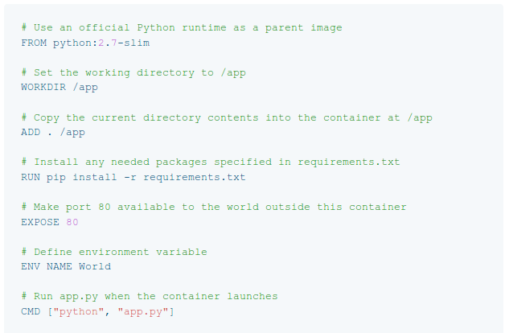
Containers can be created by using Containerfiles.

Slide 16
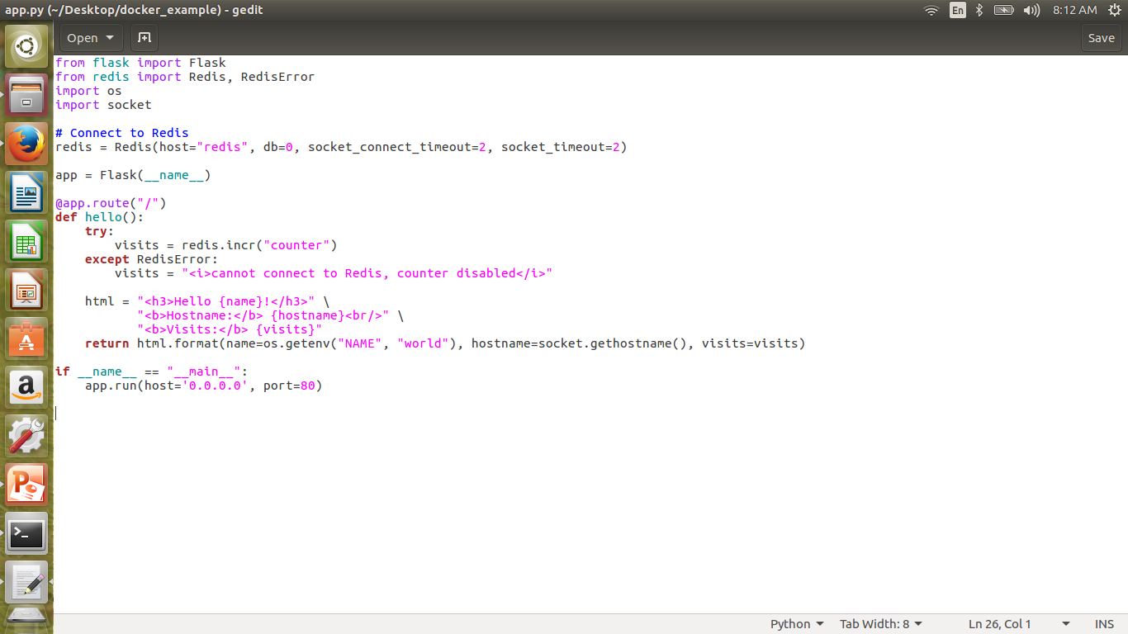
app.py Reguirements.txt
Flask
Redis

Slide 17
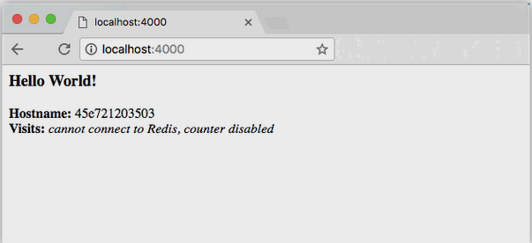
Building a app from docker file.
$docker build –t my_docker .
Running the app
$docker run –p 4000:80 my_docker
Login in-to Docker Hub
$ docker login
Publish the image
$docker push username/repository.tag

Slide 18
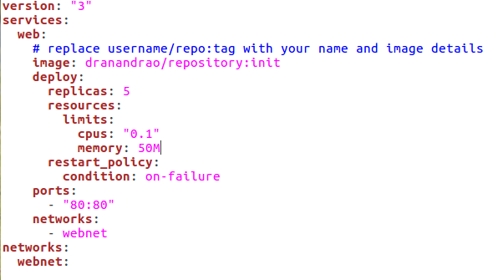
Services
Docker services are running instance of the containers.
The service file tells docker to do the things.
Pull the image from the registry.
Run 5 instances of image as service called web.
Immediately restart containers if one falls.
Map port 80 on the host to web’s port 80.
Instruct web’s containers to share port 80 via a load-balanced network called webnet.
Define the webnet network with default settings.

Slide 19
RUN LOAD-BALANCED APP
Before deploying the container we need to run
$docker swarm init.
Deploying
$docker stack deploy –c docker-compose.yml getstartedlab
Take down app and the swarm
$docker stack rm getstartedlab

Slide 20
DISADVATAGES OF DOCKERS
Dockers are good but cannot completely replace virtual machines. There are some applications that cannot be perfectly deployed in containers. Docker is good for micro-services.
Tools to manage and monitor containers are limited as of now.

Slide 21
CONCLUSION
DockerHub which provides many pre-build images. It is very positive that most third party developers share dockers idea of openness and provide pluggable modules that can be combined.
Containerization gains more and more attention since companies may develop application faster, cheaper and better. It’s a great tool and supports continuous deployment.
It can be integrated in existing configuration management tool. Since its ecosystem is big and still growing it offers many use cases.

Slide 22
REFERENCES
[1]. C. Anderson, "Docker [Software engineering]," in IEEE Software, May-June 2015, vol. 32, no. 3, pp. 102-c3.
[2]. T. Inagaki, Y. Ueda and M. Ohara, "Container management as emerging workload for operating systems," 2016 IEEE International Symposium on Workload Characterization (IISWC), Providence, RI, 2016, pp. 1-10.
[3] https://docs.docker.com/

Slide 23
Thank You…!

